Slide 1

Web intelligence: how to evaluate the business ideas using web research tools

Slide 2

Genesis Growth team
Purpose:
increase capitalization of R&D projects
Projects:
infrastructure projects – shared support
one-off requests – strategy, research, operations

Slide 3
Agenda
What is a web research
Checking market potential
Sizing the market
Defining the archetypes
Evaluating the business model
Analyzing the marketing strategy
Foreseeing the risks
Next steps

Slide 4
What is a web research
Web intelligence
Insights are gathered from publicly available data

Slide 5
What is a web research
Web intelligence
“Offline” intelligence
Insights are gathered from publicly available data
Most data are either private and inaccessible, or hard to collect

Slide 6
Agenda
What is a web research
Checking market potential
Sizing the market
Defining the archetypes
Evaluating the business model
Analyzing the marketing strategy
Foreseeing the risks
Next steps

Slide 7

Checking market potential
Define whether your niche is popular (and demanded by the audience) and that you can make a decent business there

Slide 8
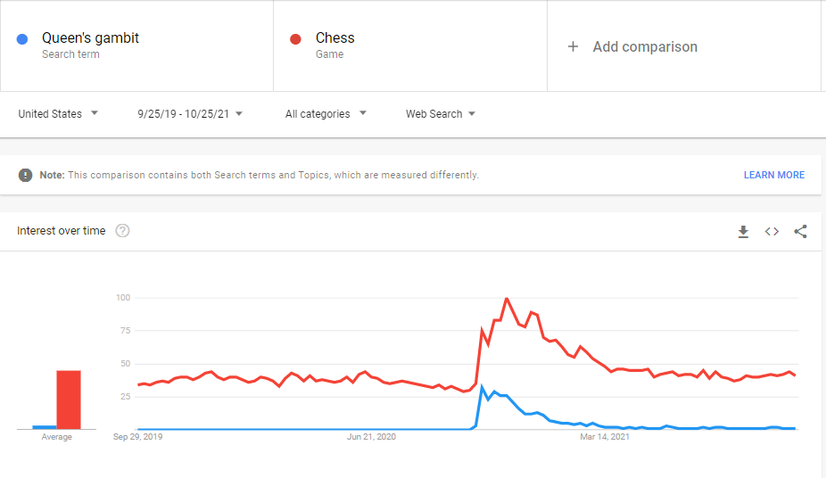
Checking market potential
Google Trends

Slide 9
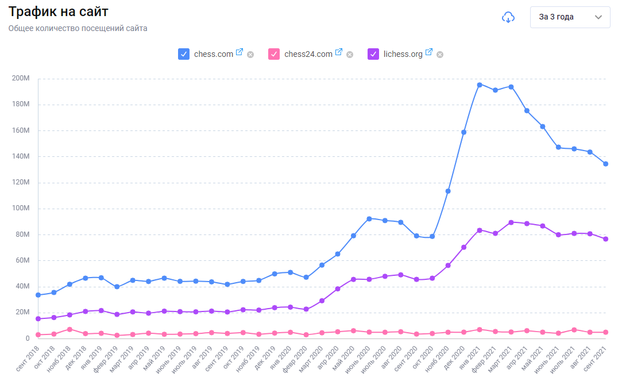
Checking market potential
Annual visits
from Metrica.guru

Slide 10
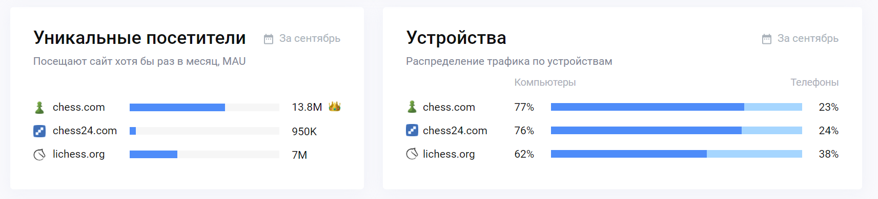
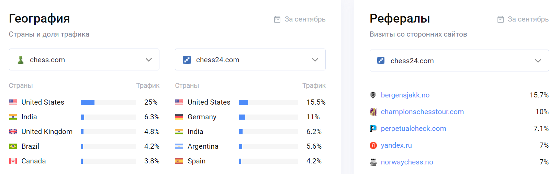
Checking market potential
Annual visits
from Metrica.guru

Slide 11
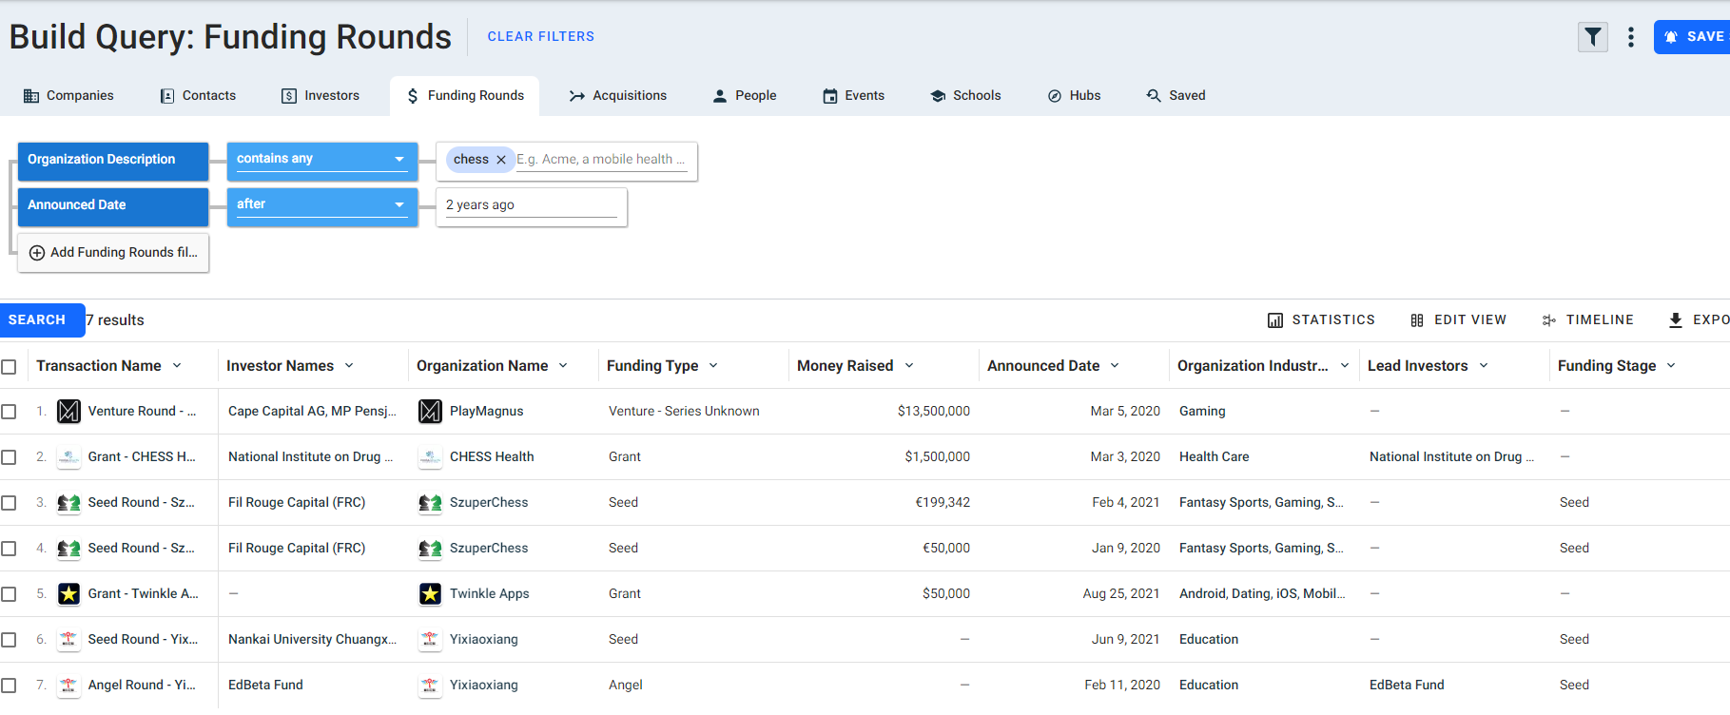
Checking market potential
Investment deals from Crunchbase.com

Slide 12
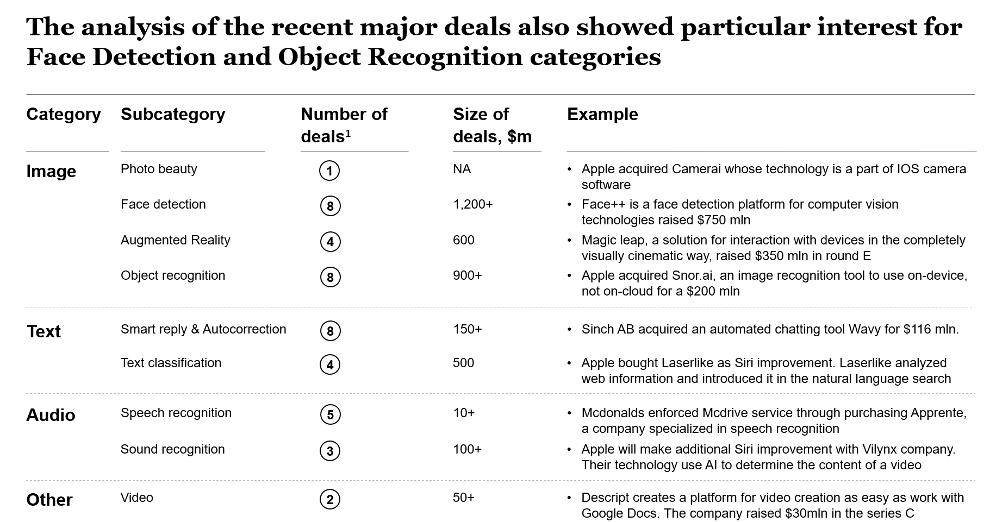
Checking market potential
Research snapshot – Machine Learning

Slide 13
Checking market potential
Define whether your niche is popular (and demanded by the audience) and that you can make a decent business there
How?
Google trends Competitors visits Industry deals

Slide 14

Q&A

Slide 15
Agenda
What is a web research
Checking market potential
Sizing the market
Defining the archetypes
Evaluating the business model
Analyzing the marketing strategy
Foreseeing the risks
Next steps

Slide 16
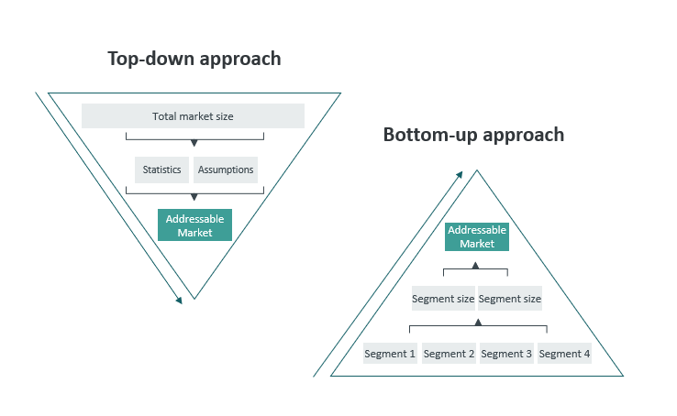
Sizing the market
Average of top-down and bottom-up

Slide 17
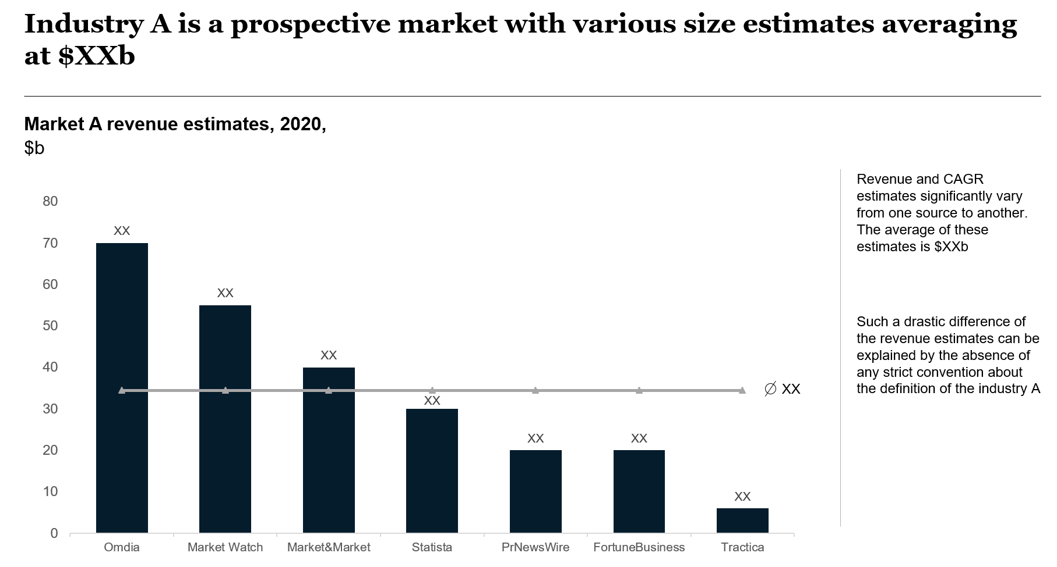
Sizing the market
Top down estimations
Research snapshot – Industry A

Slide 18
Sizing the market
Apps
Collect the apps
From public sources (SensorTower, Zoominfo) find the revenue for each peer
Summarize the estimates

Slide 19
Sizing the market
Apps
Web
Collect the apps
From public sources (SensorTower, Zoominfo) find the revenue for each peer
Summarize the estimates
Collect the number of annual visits
Multiply to conversion rate for respective industry (google it), and the average price
Summarize the revenue estimates

Slide 20
Sizing the market
Apps
Web
Collect the apps
From public sources (SensorTower, Zoominfo) find the revenue for each peer
Summarize the estimates
Collect the number of annual visits
Multiply to conversion rate for respective industry (google it), and the average price
Summarize the revenue estimates
Even after the meticulous research, there is a chance you overlooked some players. Thus, assume that your estimate is 80% of the total market, which is a number in question
Summarize the figures and divide over 80%

Slide 21
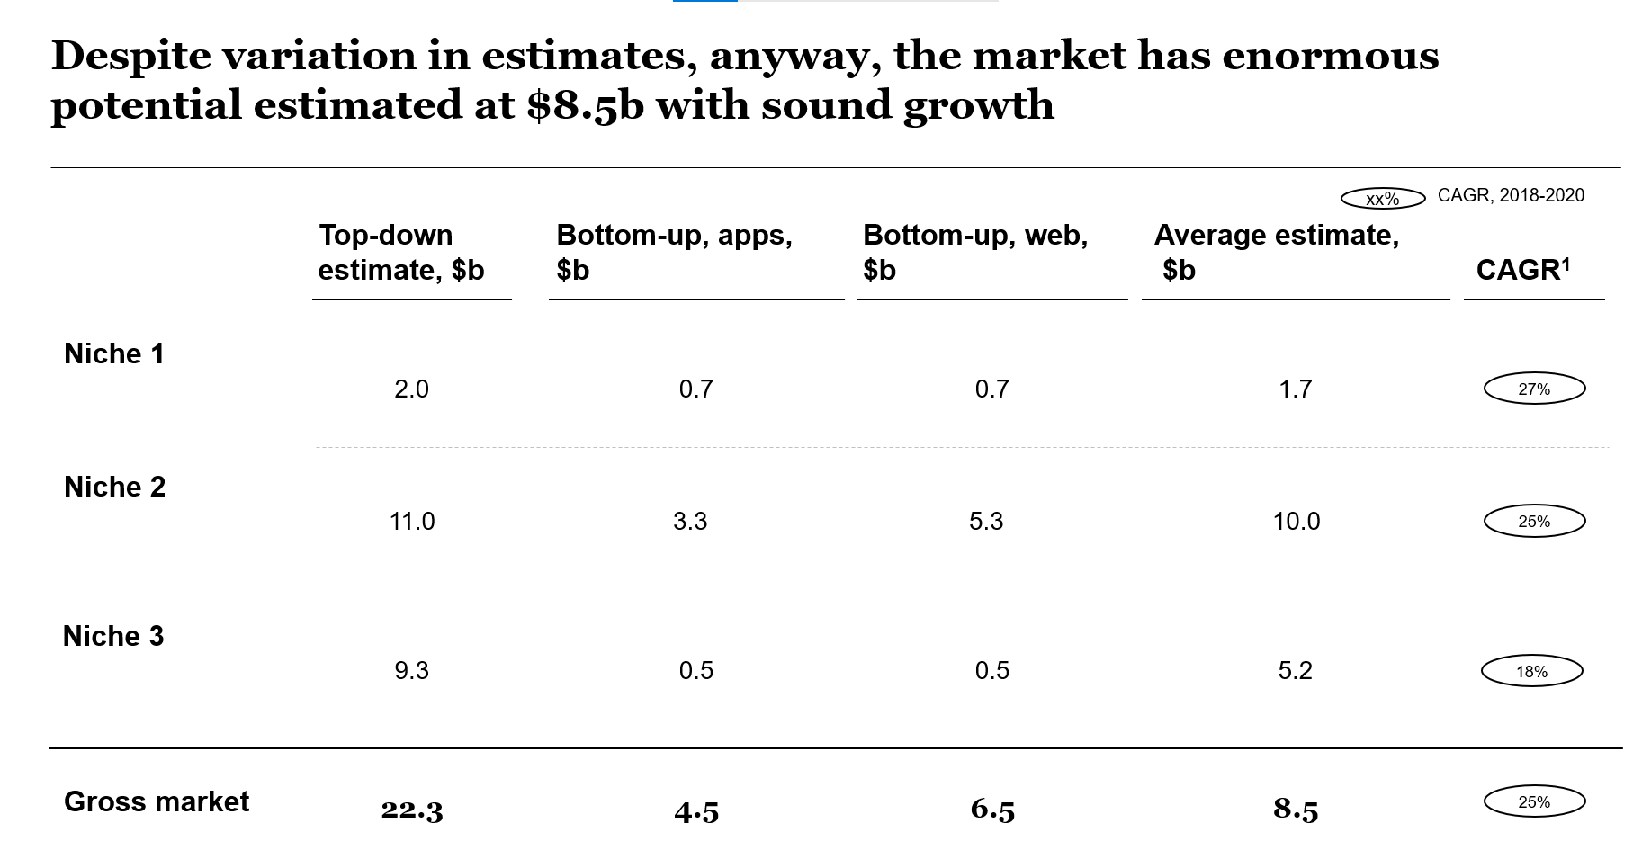
Sizing the market
Bottom-up estimations
Research snapshot – Industry В

Slide 22
Sizing the market
CAGR (Compound annual growth rate)
Shows the pace at which industry grows
Needs datapoints for several years (usually, 3-5 years)

Slide 23
Q&A

Slide 24
Agenda
What is a web research
Checking market potential
Sizing the market
Defining the archetypes
Evaluating the business model
Analyzing the marketing strategy
Foreseeing the risks
Next steps

Slide 25
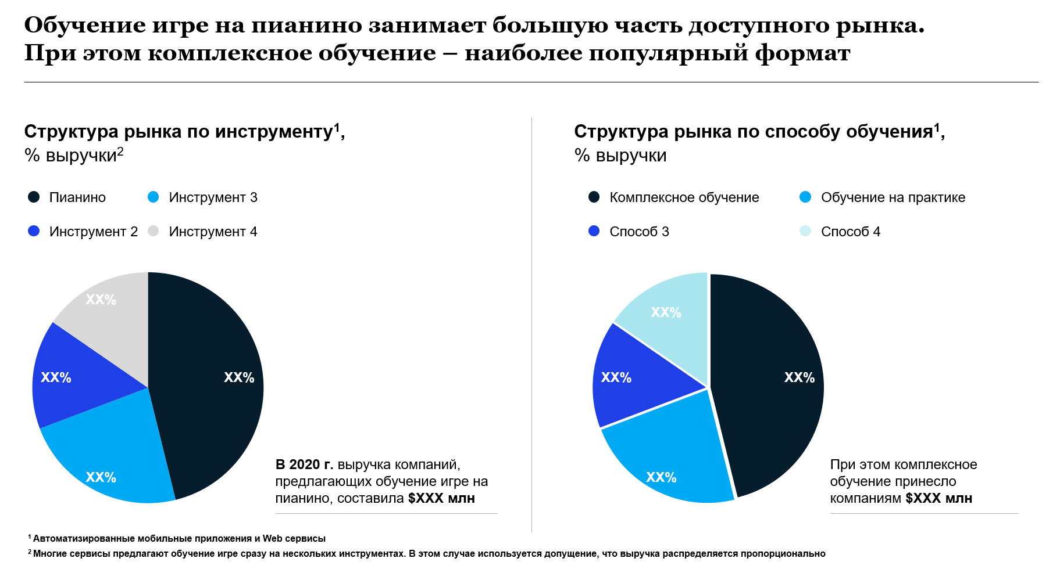
Defining the archetypes
Research snapshot – Online music education

Slide 26
Defining the archetypes
Research snapshot – Online music education
Criteria to classify
Audience
Product
Features
Pricing strategy
Geography
Business model

Slide 27
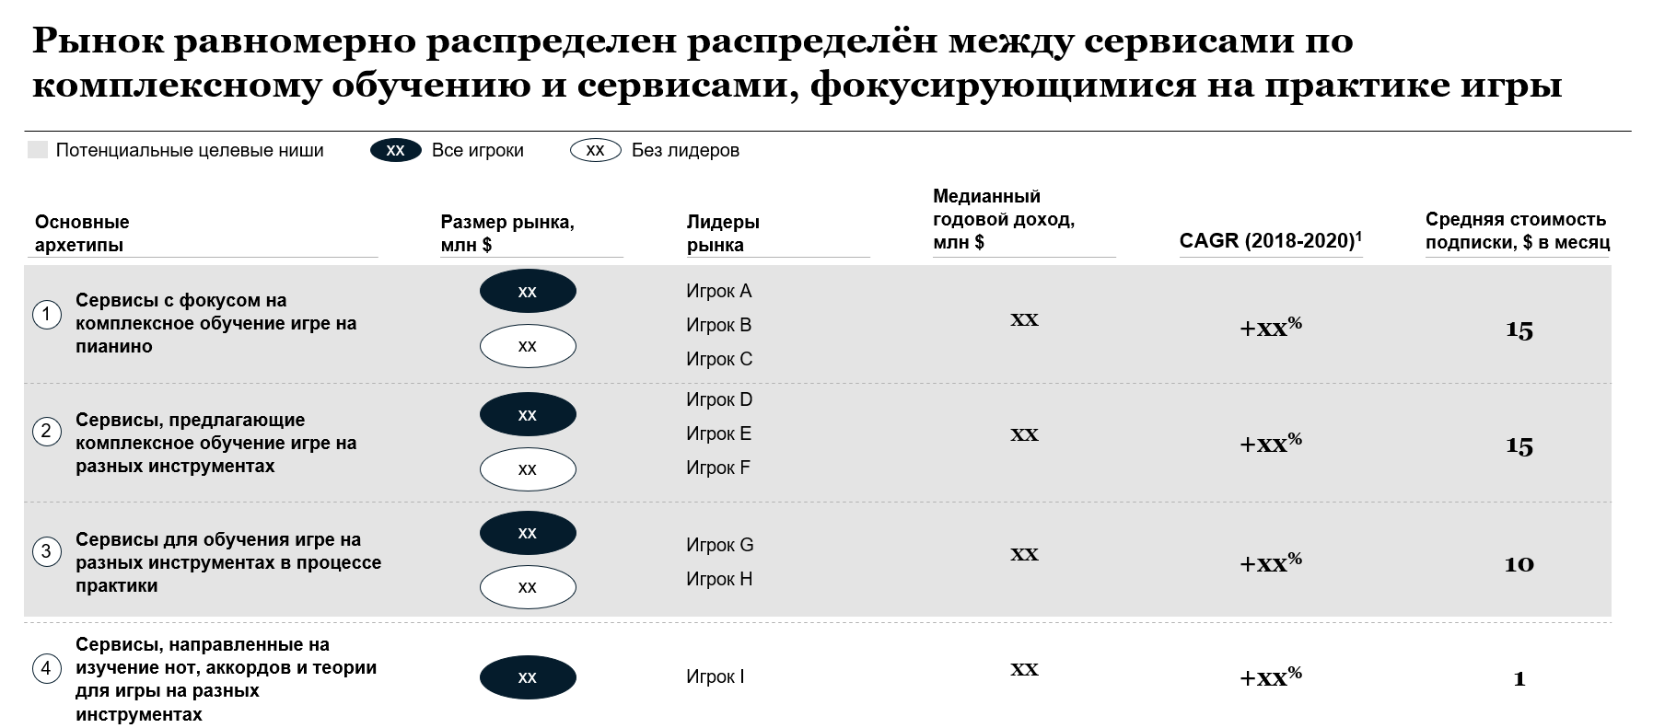
Defining the archetypes
Research snapshot – Online music education

Slide 28
Defining the archetypes
Research snapshot – Online music education
Criteria to classify
Product
Audience
Features
Pricing
Geography
Business model

Slide 29
Agenda
What is a web research
Checking market potential
Sizing the market
Defining the archetypes
Evaluating the business model
Analyzing the marketing strategy
Foreseeing the risks
Next steps

Slide 30
Evaluating the business model
Types
In-app advertising
In-app purchases
Freemium
Paid apps
Subscription

Slide 31
Evaluating the business model
Types
Apps
In-app advertising
In-app purchases
Freemium
Paid apps
Subscription
YouTube
Kindle, games
Angry Birds
Facetune
Tinder

Slide 32
Agenda
What is a web research
Checking market potential
Sizing the market
Defining the archetypes
Evaluating the business model
Analyzing the marketing strategy
Foreseeing the risks
Next steps

Slide 33
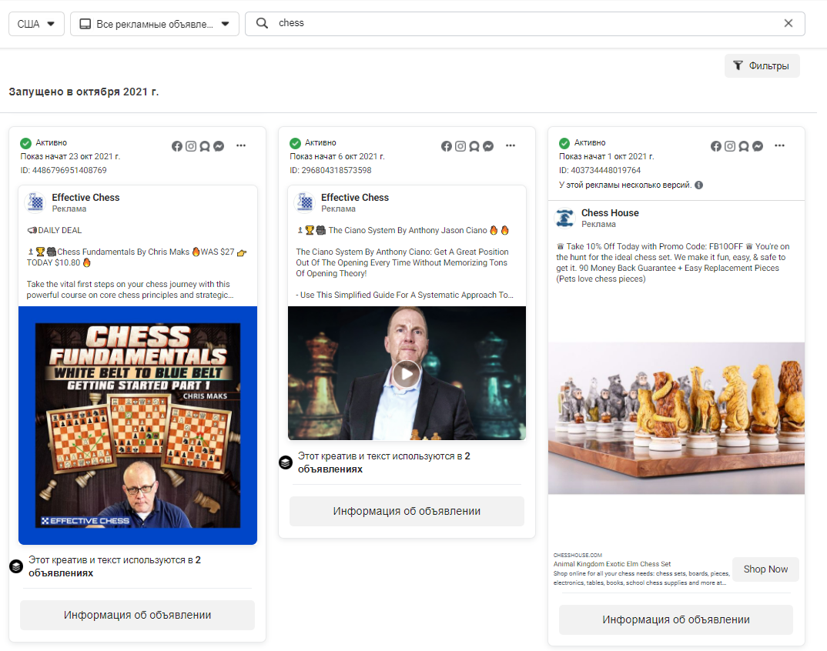
Analyzing the marketing strategy
Facebook Ads Library

Slide 34
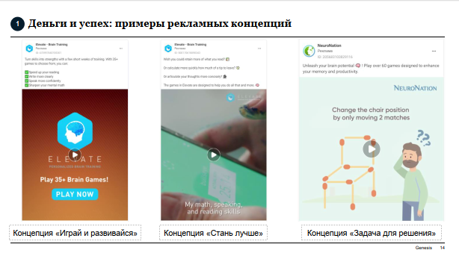
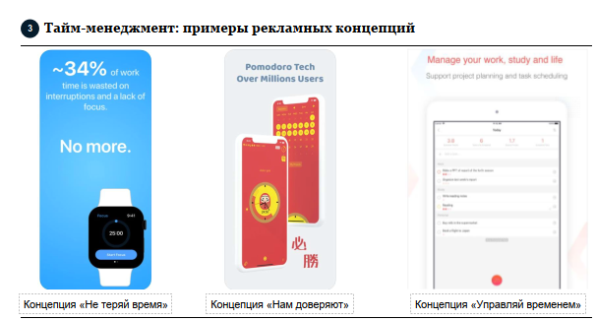
Analyzing the marketing strategy
Research snapshot – Personal development strategy
Facebook Ads Library

Slide 35
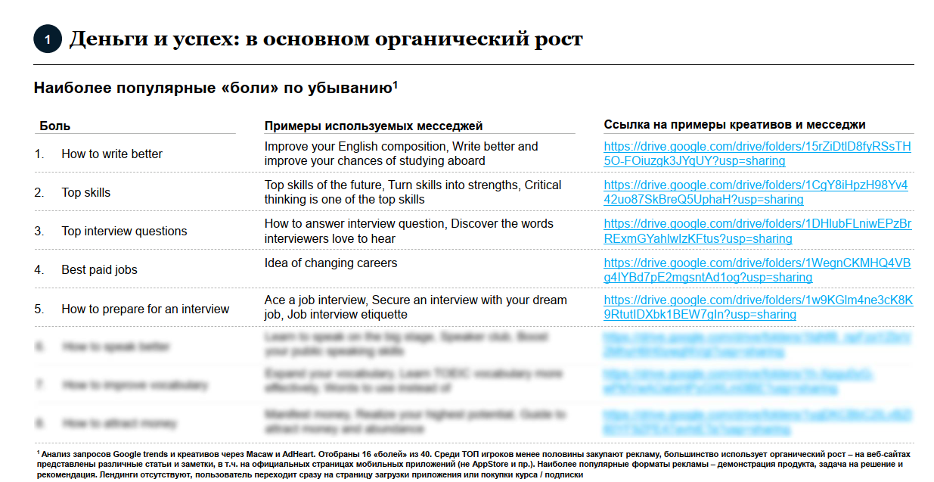
Deep dive
Research snapshot – Personal development strategy

Slide 36
Agenda
What is a web research
Checking market potential
Sizing the market
Defining the archetypes
Evaluating the business model
Analyzing the marketing strategy
Foreseeing the risks
Next steps

Slide 37
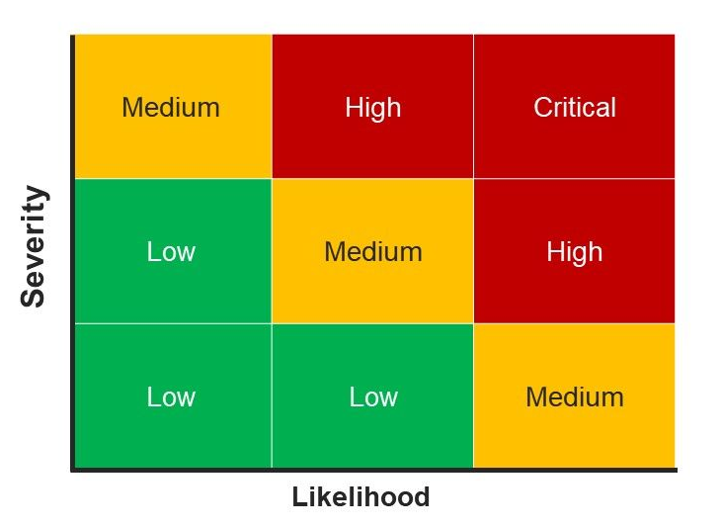
Foreseeing the risks

Slide 38
Foreseeing the risks
Examples for dating
Creatives are blocked by Facebook
GDPR violation
Creatives do not account for changes in demographic structure (gender distribution, immigration)

Slide 39
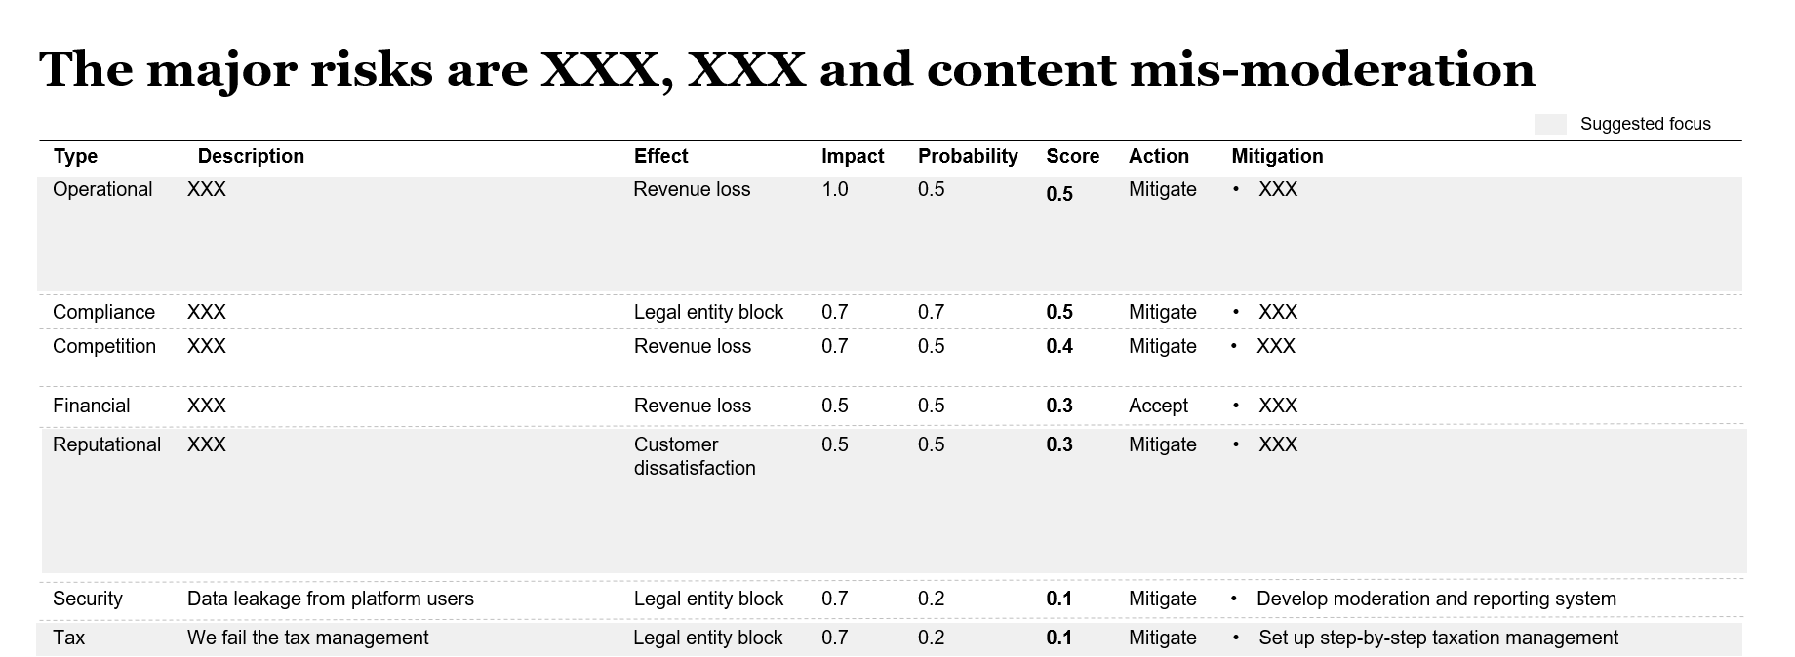
Foreseeing the risks
Research snapshot – Industry B

Slide 40
Agenda
What is a web research
Checking market potential
Sizing the market
Defining the archetypes
Evaluating the business model
Analyzing the marketing strategy
Foreseeing the risks
Next steps

Slide 41

For questions:
Hanna Oleksiienko
@hanna_oleksiienko

Slide 42
To join us:
Contact growth@gen.tech for a test task with a subject
[EBEC workshop]
[Test task]

